Slide 1
Choosing the right Deep Learning Framework: A Deep Learning Approach
Nick Acosta
IBM Data Science Community

Slide 2
Which Deep Learning Framework should I be using for neural network development?

Slide 3
Deep Learning Frameworks Advice
Content usually falls into three camps

Slide 4
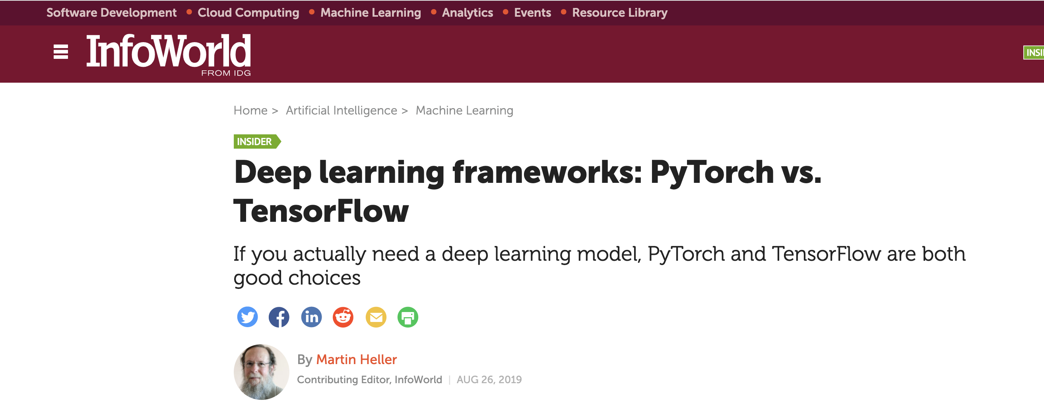
Deep Learning Frameworks Advice
Content usually falls into three camps
historical overview

Slide 5

Deep Learning Frameworks Advice
Content usually falls into three camps
historical overview
explanation of differences

Slide 6
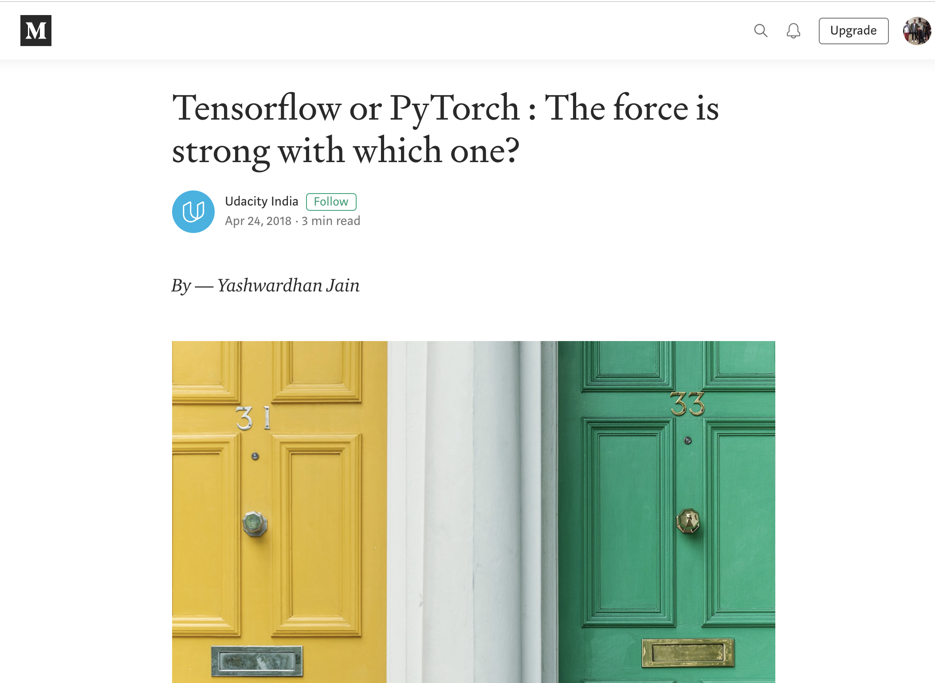
Deep Learning Frameworks Advice
Content usually falls into three camps
historical overview
explanation of differences
advisory of preference

Slide 7
Deep Learning Frameworks Advice
Content usually falls into three camps
historical overview
explanation of differences
advisory of preference
Some are combination of three, but most have an advisory voice

Slide 8
Deep Learning Frameworks Advice
Content usually falls into three camps
historical overview
explanation of differences
advisory of preference
Some are combination of three, but most have an advisory voice
prone to
subjectivity
anecdotal evidence
current state of deep learning frameworks

Slide 9
Start with the framework chosen for you via Deep Learning.

Slide 10
Agenda
Part One - Introduction 01
"Deep Learning Frameworks Advice" 03
Agenda 10
Part Two - Deep Learning Frameworks 11
Deep Learning Frameworks 12
TensorFlow 14
PyTorch 17
Part Three - Data 20
Data Source 22
Preparation for Deep Learning 25
Part Four - Models 26
Overview 27
Results 28
Part Five - Conclusion 30
Resources 31

Slide 11
Deep Learning Frameworks

Slide 12
Deep Learning Frameworks
Allow for easy construction of neural networks

Slide 13
Deep Learning Frameworks
Allow for easy construction of neural networks
Abstract away lowest level detail
Standardize commonly used neural network concepts, from components to models
Provide tooling for deployment on various hardware configurations, including GPUs

Slide 14
TensorFlow
From Google via Google Brain
Late 2015
Build for distributed computing
Tensor - default data structure
n-dimensional array
Flow - execution via computational graph
C++ (CUDA) backend
mixed frontend

Slide 15
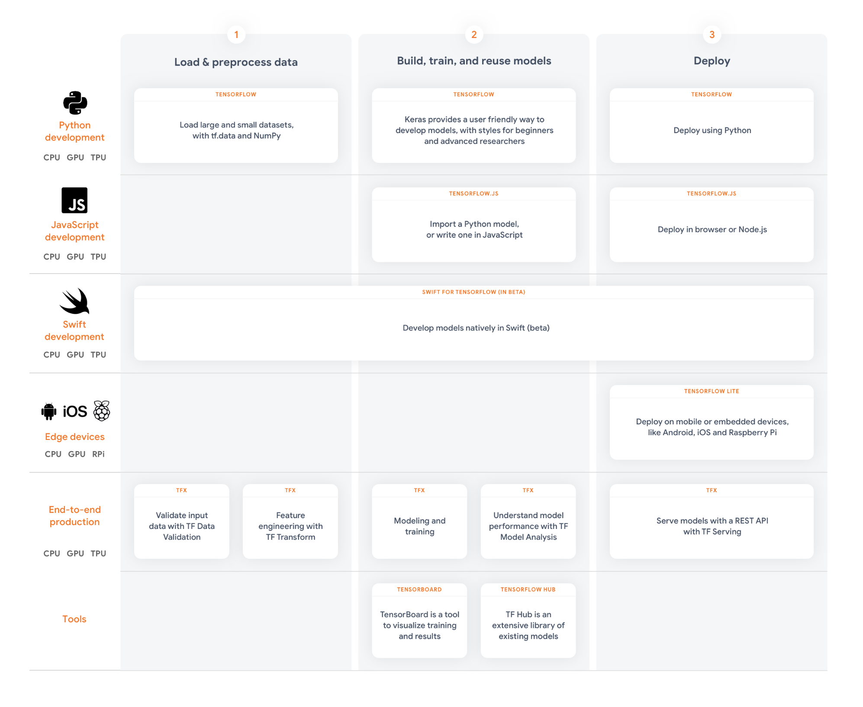
TensorFlow
From Google via Google Brain
Late 2015
Build for distributed computing
Tensor - default data structure
n-dimensional array
Flow - execution via computational graph
C++ (CUDA) backend
mixed frontend

Slide 16
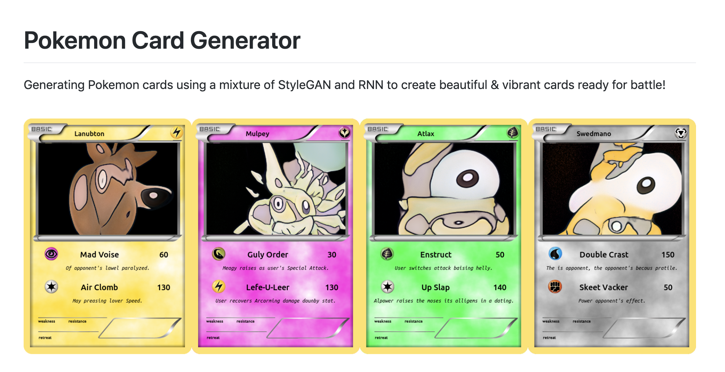
TensorFlow Case Study

Slide 17
PyTorch
From Facebook via Torch (and Caffe2)
Late 2016
Build for research in deep learning
Tensor - default data structure
n-dimensional array
Torch – scientific computing and machine learning library
Torch C/CUDA backend
Python frontend

Slide 18

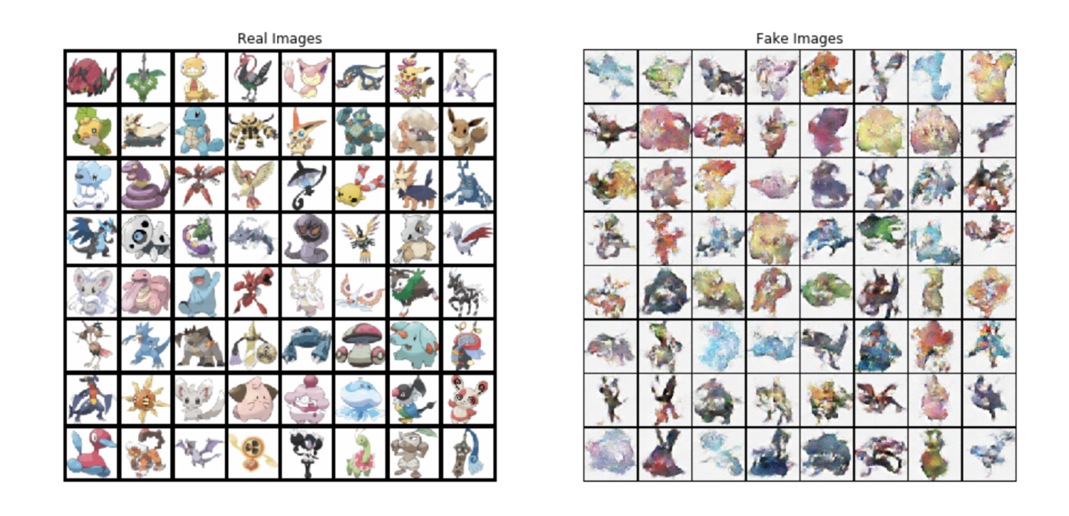
PyTorch Case Study

Slide 19
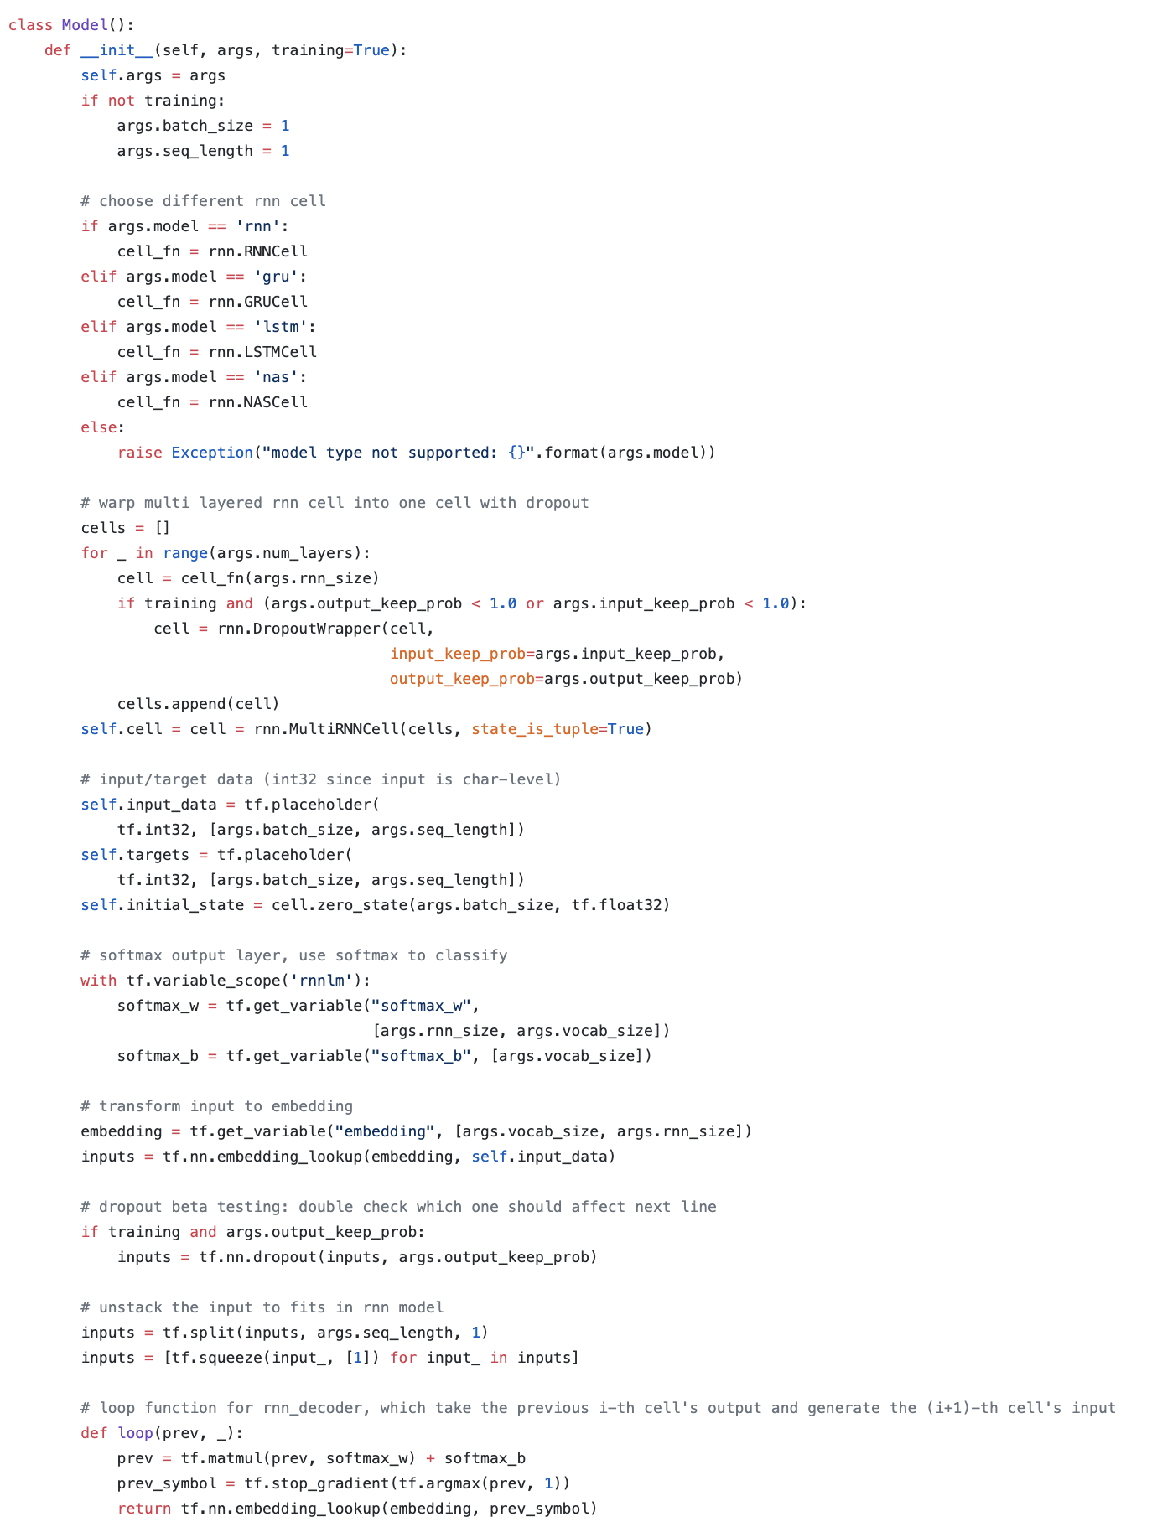
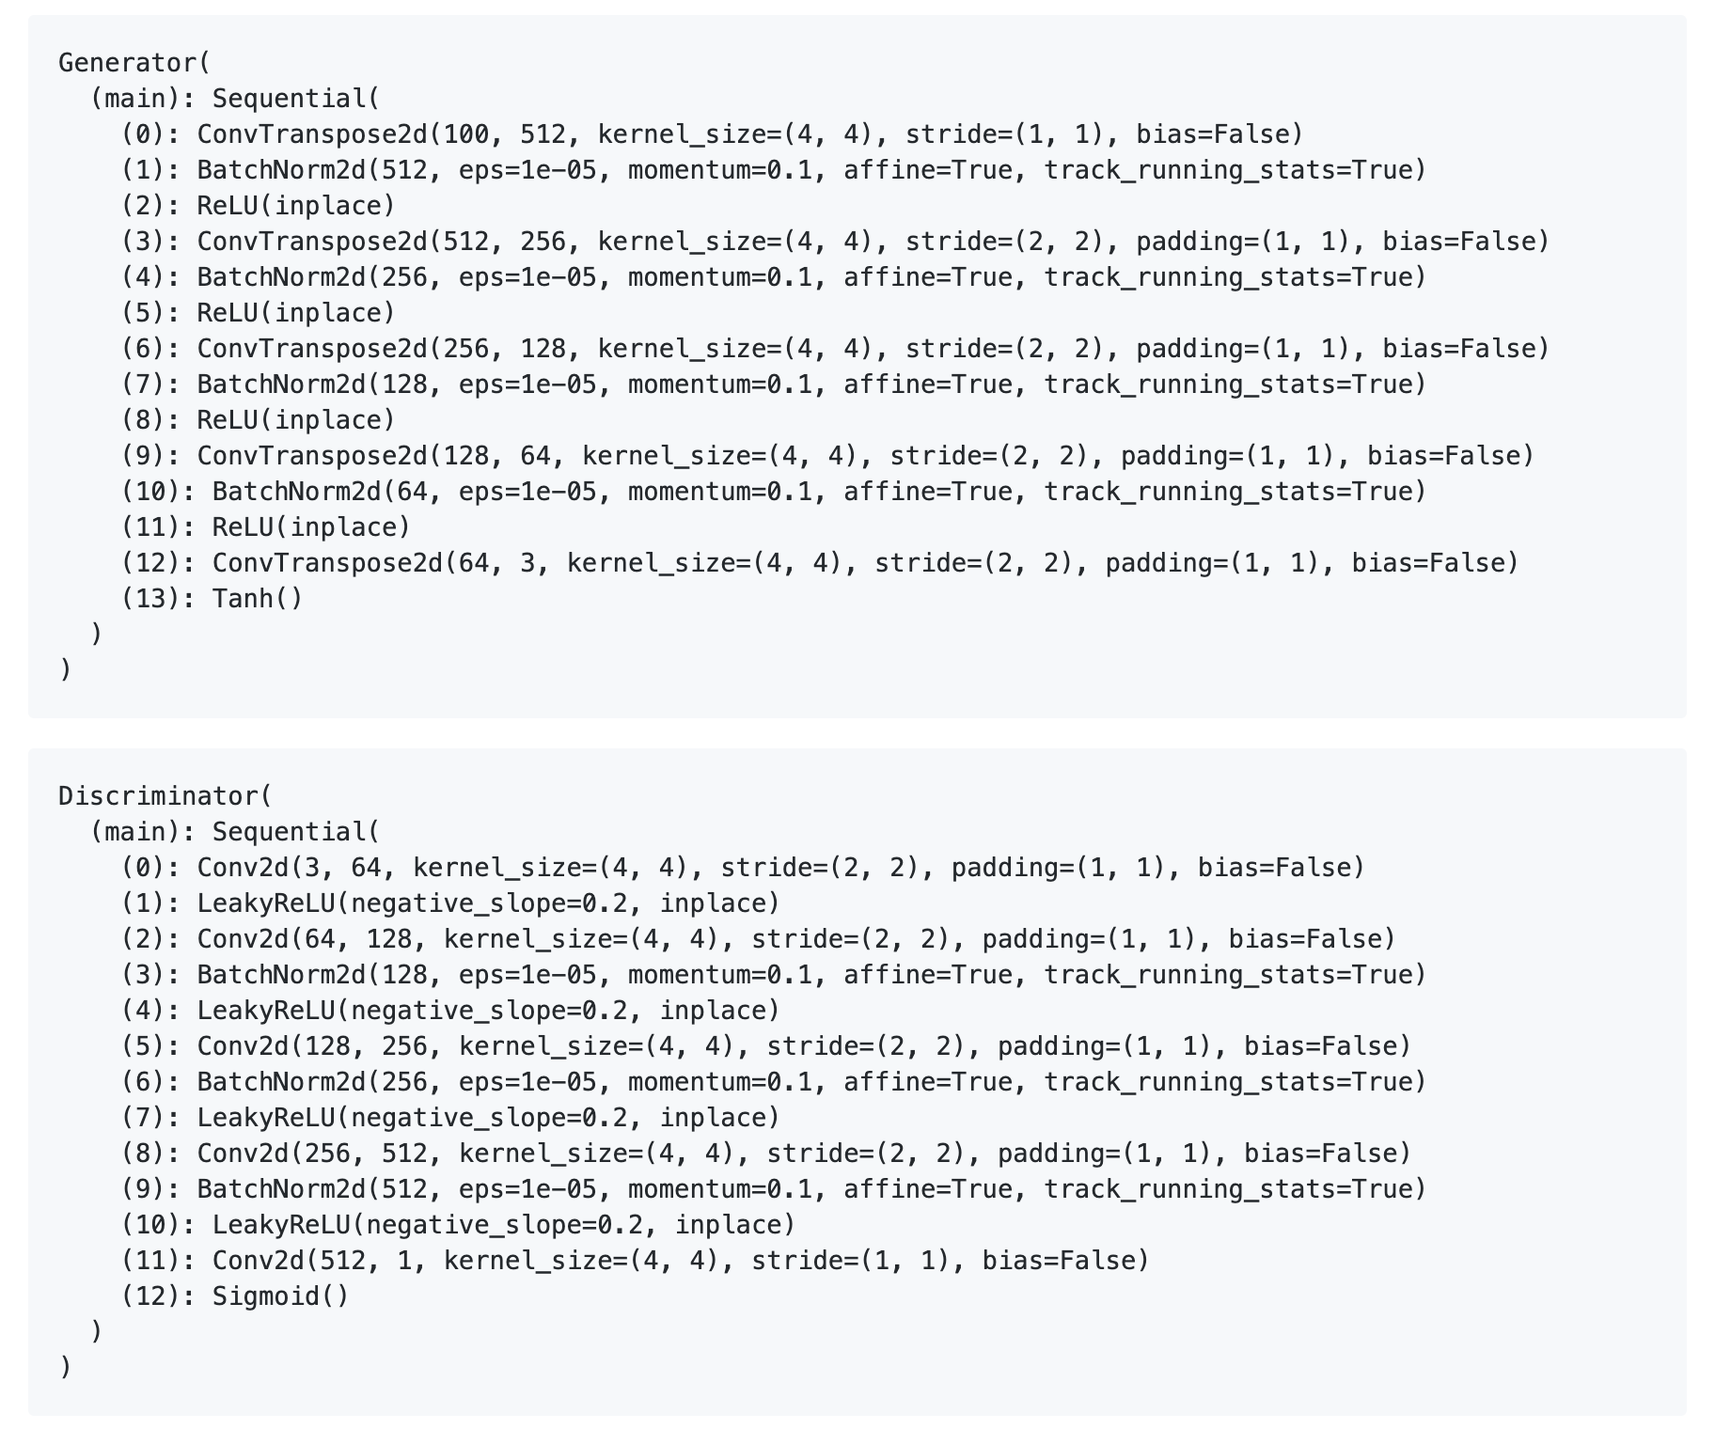
Differences

Slide 20
Data

Slide 21
Classes

Slide 22
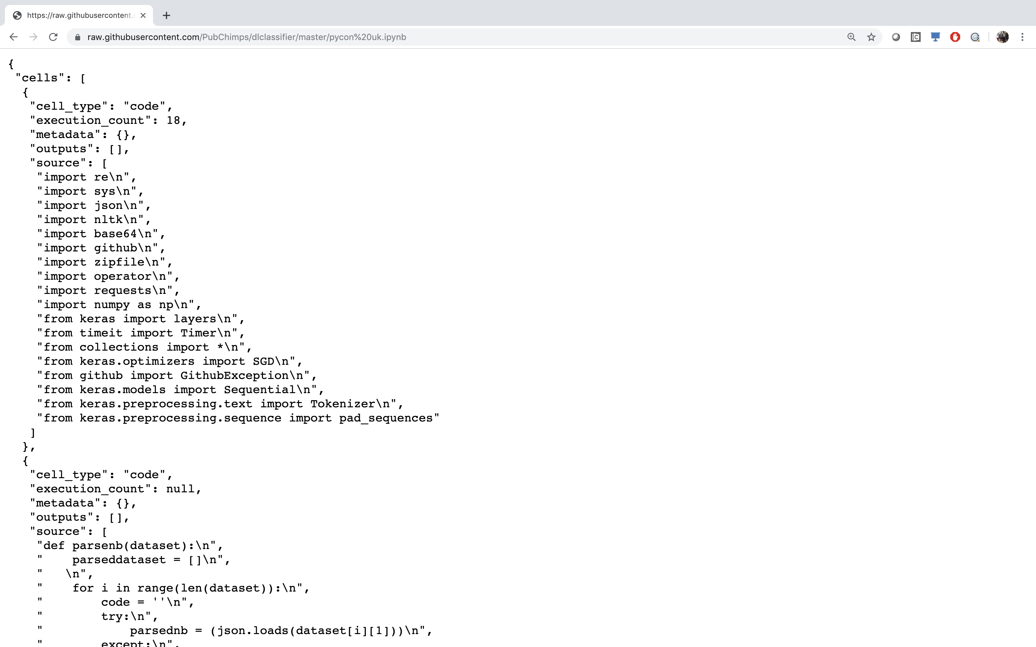
PyGitHub

Slide 23
PyGitHub
[['import re import sys import json import nltk import base64 import github import zipfile import operator import requests import numpy as np import tensorflow as tf from collections import from keras optimizers import SGD from github import GithubException from keras preprocessing text import Tokenizerfrom keras preprocessing sequence import pad sequences print tf version def parsenb dataset parseddataset for i in range len dataset code try parsednb json loads dataset i 1 except print str i str sys exc info for j in range len parsednb cells if parsednb cells j cell type code code code join parsednb cells j source parseddataset append code dataset i 2 … ', 'tensorflow’]
[['import re import sys import json import nltk import base64 import github import zipfile import operator import requests import numpy import from collections import from optimizers import SGD from github import GithubException from preprocessing text import Tokenizerfrom preprocessing sequence import pad sequences print version def parsenb dataset parseddataset for range len dataset code try parsednb json loads dataset except print str str sys exc info for range len parsednb cells if parsednb cells cell type code code code join parsednb cells source parseddataset append code dataset … ', 'tensorflow']

Slide 24
Stats
set 1 set 2 set 3
split 70/30 tensorflow 57/43 tensorflow 59/41 tensorflow
repos - 2270 2680
notebooks 5351 8120 9563
total words 3,105,210 4,951,835 5,904,549
unique words 35,214 55,023 61,876

Slide 25
Data Preparation
Bag of Words (One-Hot Encoding)
Each element in dataset becomes feature vector
representation of every word in dataset
Full Representation of data
Extremely sparse
Text Embedding
Translate dataset to a lower dimensional, more dense space
Increases number of hyperparameters
Common, predefined text embedding (define semantics)
Trainable within neural network

Slide 26
Models

Slide 27
4 Chosen
Bag of Words (One-Hot Encoding)
Dense Neural Network
Text Embedding
Dense Neural Network
TextCNN - (TextLeNet)
TextVGG

Slide 28
Results

Slide 29
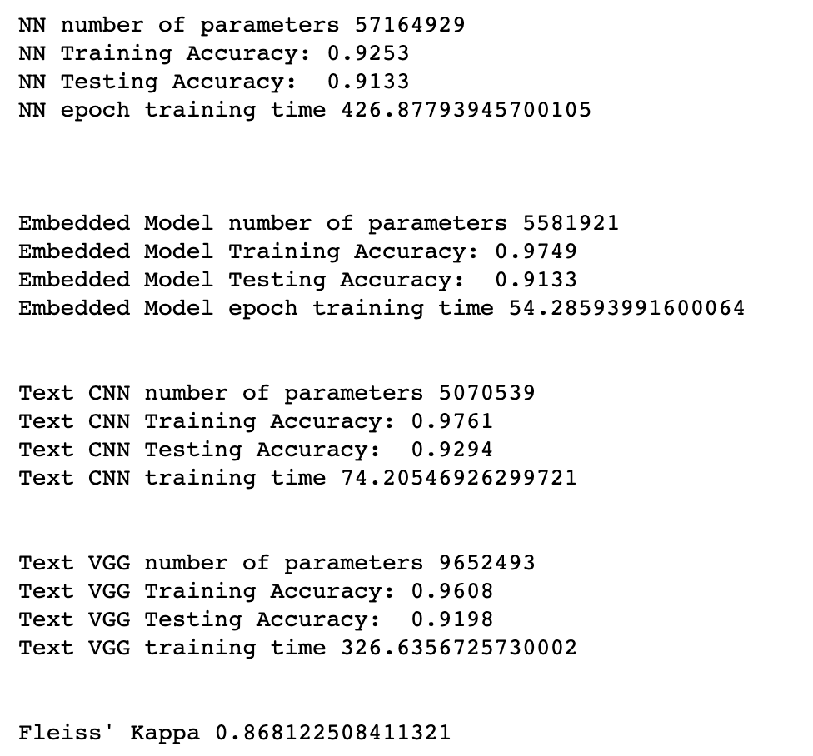
Results - Accuracy

Slide 30
The End

Slide 31
Resources
dlclassifier.mybluemix.net/
github.com/PubChimps/dlclassifier
ibm.com/community/datascience/
developer.ibm.com/callforcode/projects/

Slide 32
Thank You
Nick Acosta
Developer Advocate
—
nacosta@us.ibm.com

